Slide 1
Multi Contents Registration Manual
National Institute of Informatics 2013-02-17

Slide 2
Overview
This manual instruct how to deposit multiple contents at the same time under the following conditions.
Metadata of multiple contents have to be prepared by MS-Excel file.
Windows application named “SWORD Client for WEKO” is used for this multiple deposit.
This manual composed by the following steps.
Installing SWORD Client for WEKO
Contents Preparation

Slide 3
1. Installing SCfW

Slide 4
1. Get and Install SCfW
SWORD Client for WEKO can be downloaded from
  http://weko.at.nii.ac.jp/download/SCfW-e/
  under the above directory, please get the newest version.
Open the downloaded zip file
Click the “setup.exe”
  At the MeCab install, please select SHIFT-JIS charset

Slide 5
2. Account Setup

Slide 6
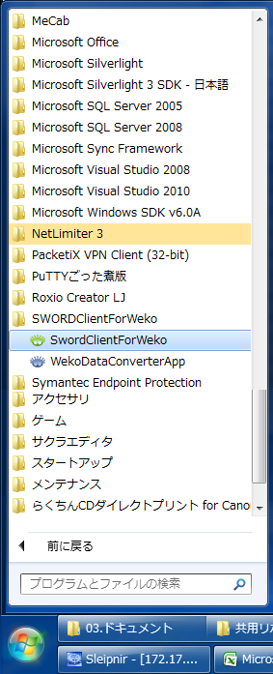
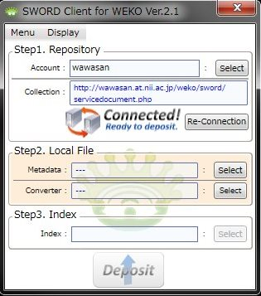
2-1. Start SWORD Client for WEKO
In the Windows Start Menu, select,
[All Program]=>[SwordClientForWeko]=>[SwordClientForWeko]

Slide 7
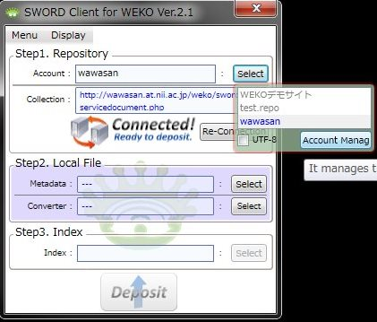
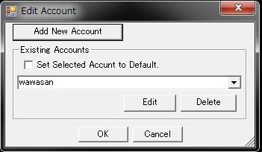
2-2 Open Account Management Window
Click [Step1. Repository]=>[Account]=>[Select] button
Click [Account Manag] button
Now you can get an Edit Account Window

Slide 8
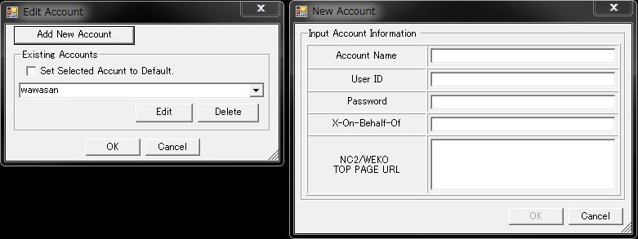
2-3. Add New Account
Click [Add New Account]
In the [New Account] window following information have to be registered.
  Account Name: [Display name to distinguish this account]
  User ID: admin
  Password: admin
  X-On-Behalf-Of: [none]
  NC2/WEKO TOP PAGE URL: http://localhost

Slide 9
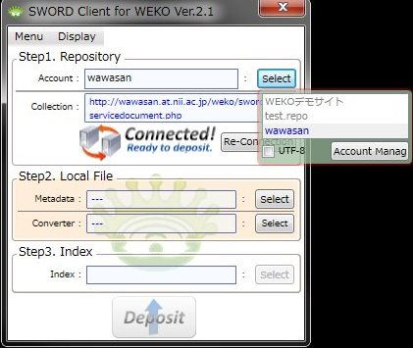

2-4. Account Select
Select Account
If [Collection] section shows
“Connected!”, your account
information is properly
registered.
  If SCfW shows “Disconnected”
  please check the account
  information carefully.

Slide 10
3. Contents Preparation

Slide 11
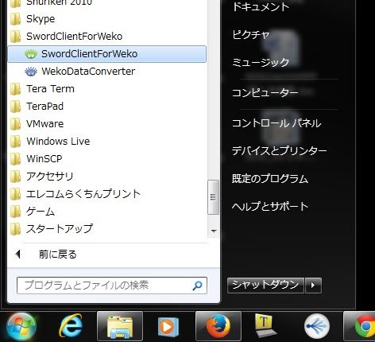
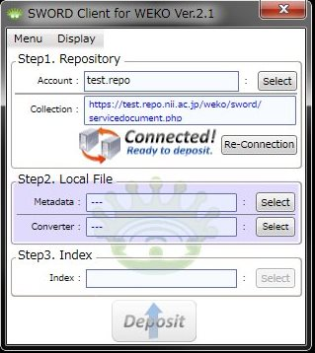
3-1. Download a Excel template file (1/2)
Start the SCfW
[Step2. Local File]=>[Converter]
=> Click [Select]

Slide 12
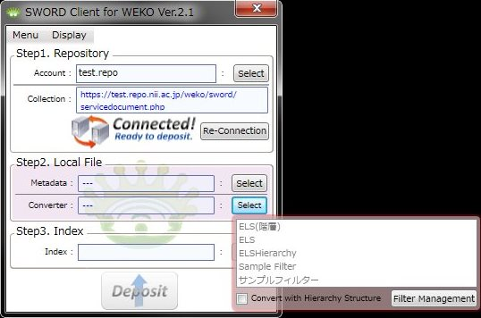
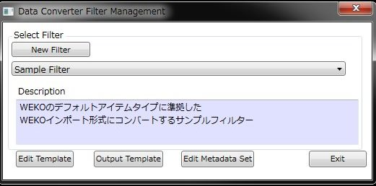
3-1. Download a Excel template file (2/2)
Click “Filter Management”
Select filter from the dropdown list
  For example, “Learning Materials”
Click “Output Template”
Notes:
名前をつけて保存

Slide 13
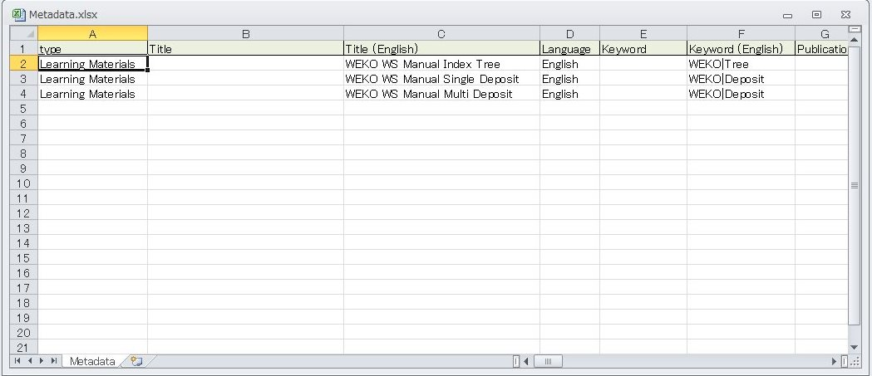
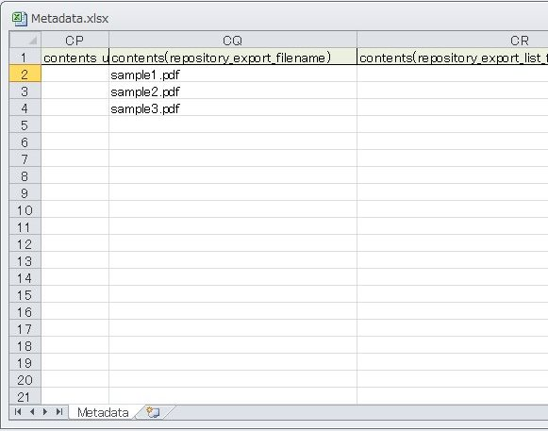
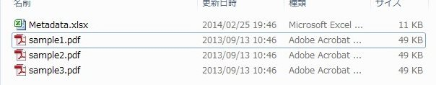
3-2. Metadata Preparation
By using the downloaded metadata template, you can prepare the metadata file.
  In case of “Learning Materials” item type, contents file name should be described in the CQ cell. If you write the file name alone, the real files have to be stored in the same folder with excel files otherwise you have to provide relative path before the file name in the CQ cell.

Slide 14
4. Multiple Deposit

Slide 15
4-1. Start SWORD Client for WEKO
In the Windows Start Menu, select,
[All Program]=>[SwordClientForWeko]=>[SwordClientForWeko]

Slide 16
4-2. Select Account
In the [Step1. Repository], click [Account]=>[Select] button, then select an account from the list.
Conform this “Connected!” sign

Slide 17
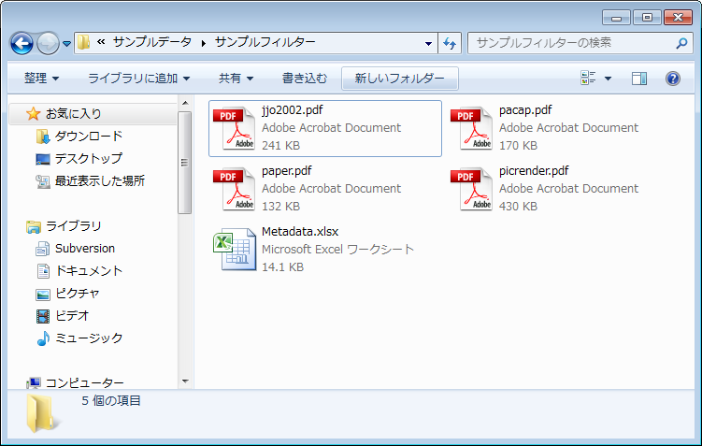
4-3. Metadata File
Click [Step2. Local File]=>[Select] button
=> File dialog window will be appeared.
Select the metadata file you created in section 3 in this manual.
=>Select prepared metadata file (*.xls, *.xlsx)
Click “Select” button and
choose metadata file.

Slide 18
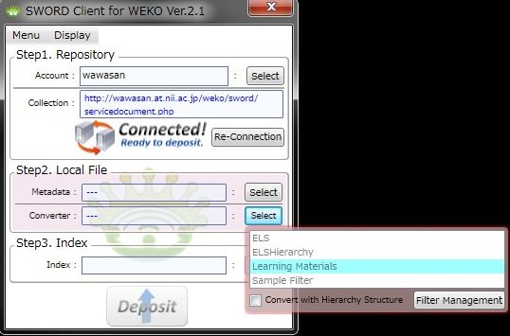
4-4. Converter
Click [Step2. Local File]=>[Converter]=>[Select] button
Select an filter from the drop down list.
  Please select “Learning Materials” in case of WS.
Click “Select” and choose
“Learning Materials”

Slide 19
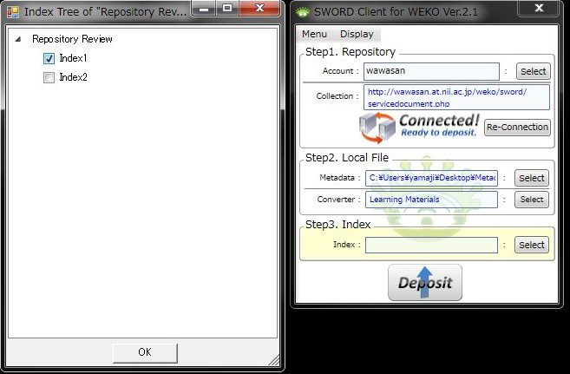
4-5. Index Tree
Click [Step3. Index]=>[Index]=>[Select] button.
Check the index from the tree.
Click “Select”

Slide 20
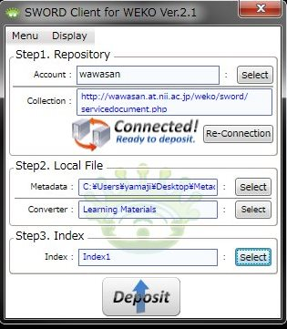
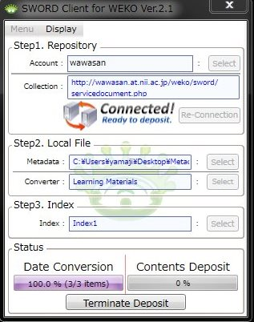
4-6. Contents Deposit
Click “Deposit” button
  => Before deposit SCfW generate import file.

Slide 21
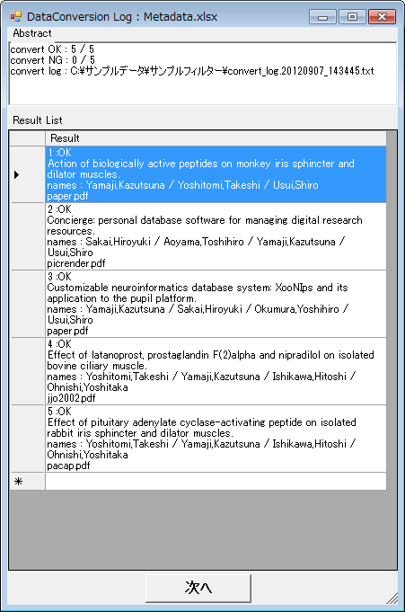
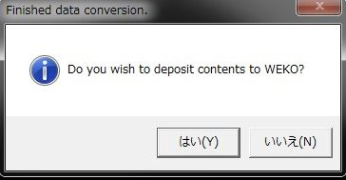
4-7. Deposit Confirmation
Confirm the data conversion, then click “Next” button.

Slide 22
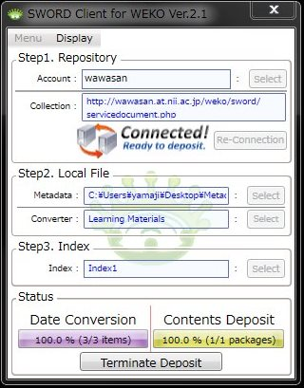
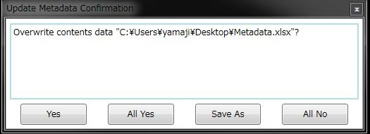
4-8. Deposit to the Repository
Contents deposit to the repository will be started.
Select “Save As” and then save the metadata file.
Start Deposit

Slide 23
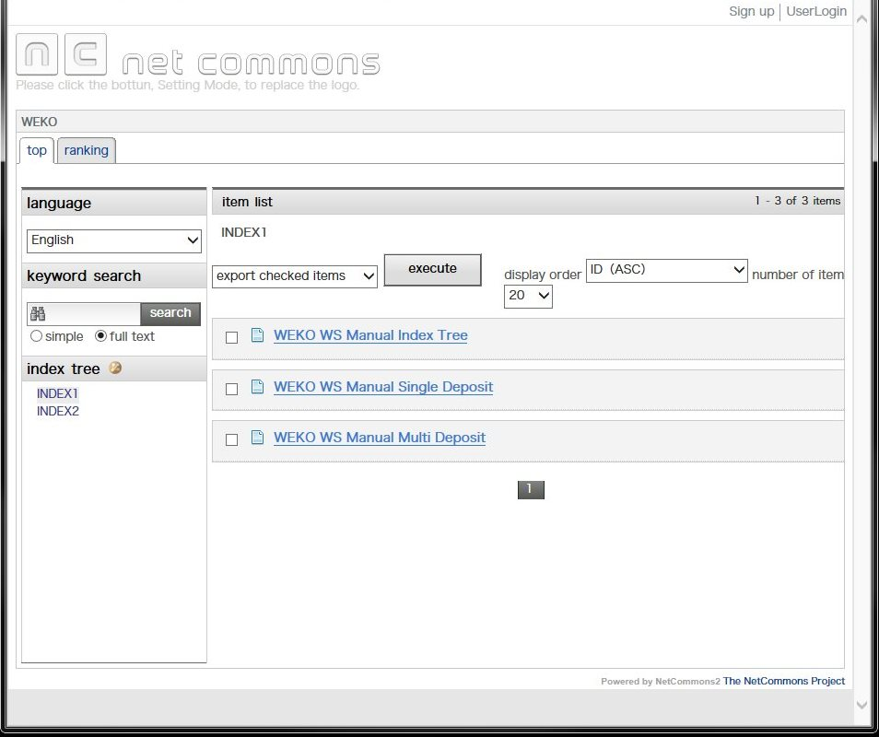
4-9. Final Confirmation
Confirm the contents which were registered from the SCfW.
Publication date in the metadata will be applied to the date when the contents open in public.

