Slide 1
Single Contents Registration Manual
National Institute of Informatics 2013-02-17

Slide 2
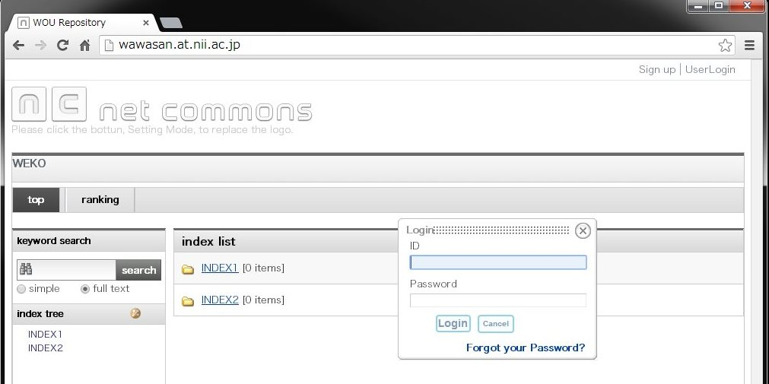
1-1. Login
Click UserLogin link which is located on the right top of the page.
  Login dialog will be appeared.
Input user account and passowrd.
Click Login button.
1
ID：admin
Password：admin
2
3

Slide 3
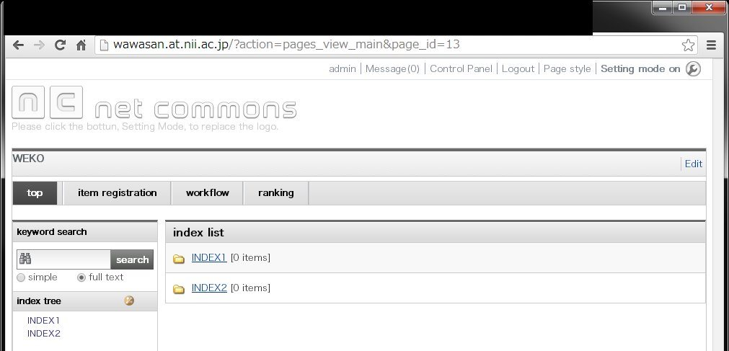
1-2. Successfully Login
Header menu will be changed after login.

Slide 4
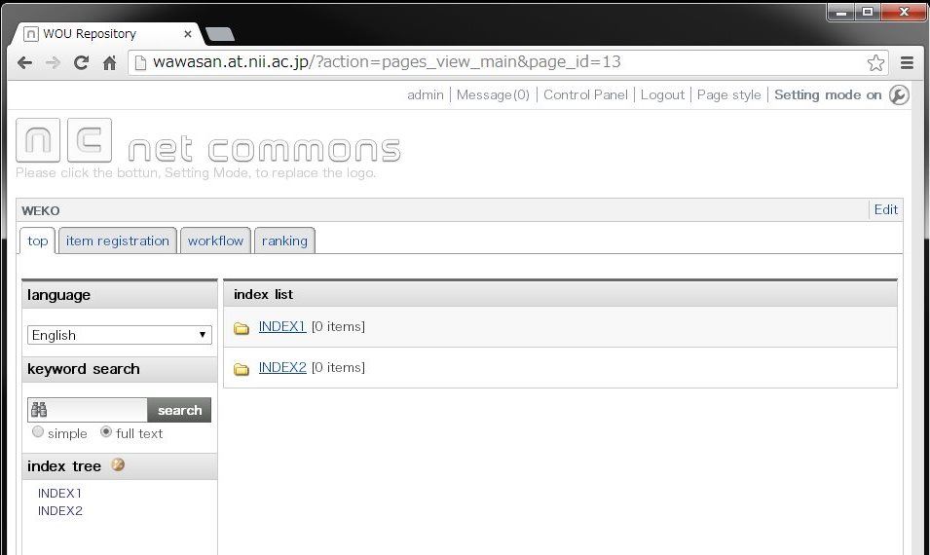
2. Access to Item Registration Menu
Select “item registration” tab
  => Item ⇒ Item registration screen will be appeared.
Click!

Slide 5
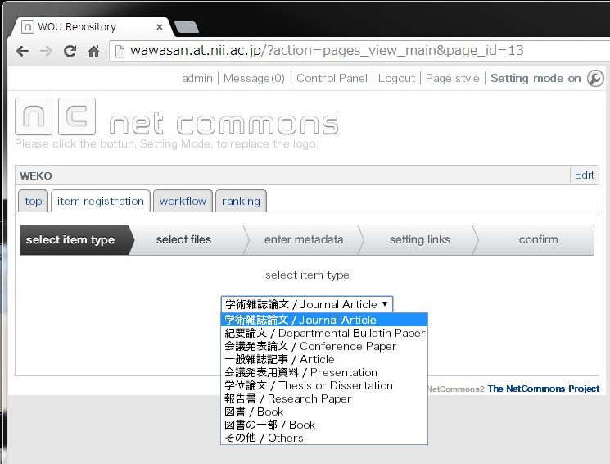
3. Item Type (Metadata Set) Select
Select appropriate item type from the pull down menu
Once you select the item type, it wouldn’t be changed.
Click “Next” button

Slide 6
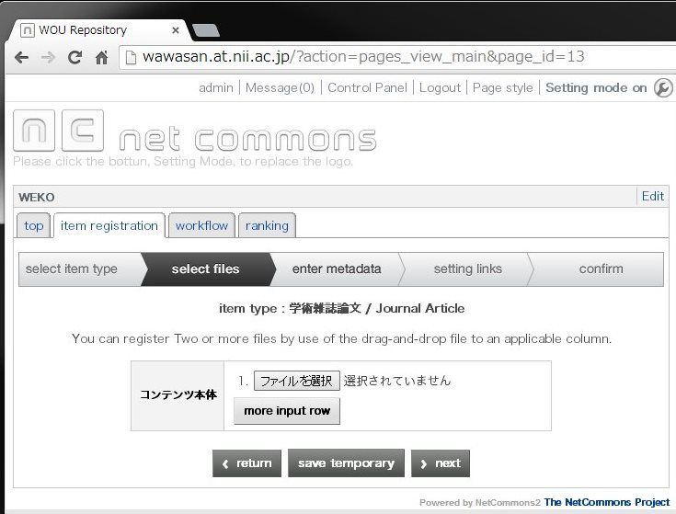
4. File Attachment
Select contents file from your local machine.
  “More input row” allow you to register multiple files.
Click “Next” button
1. Select File
“save temporary” saves registration information until this stage.
2. Click Next

Slide 7
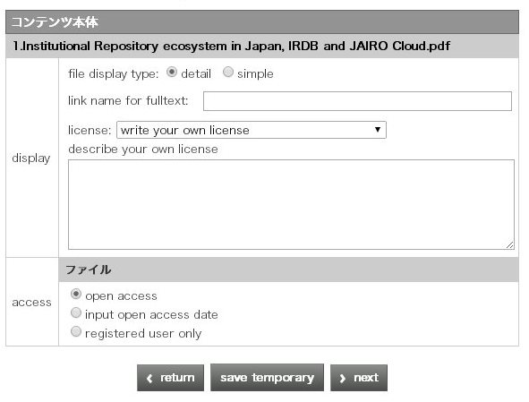
5. File License and Access Control (1/7)
Customized link name can be provided.
  If none, contents file name will be appeared as the link
Input display link name if necessary

Slide 8
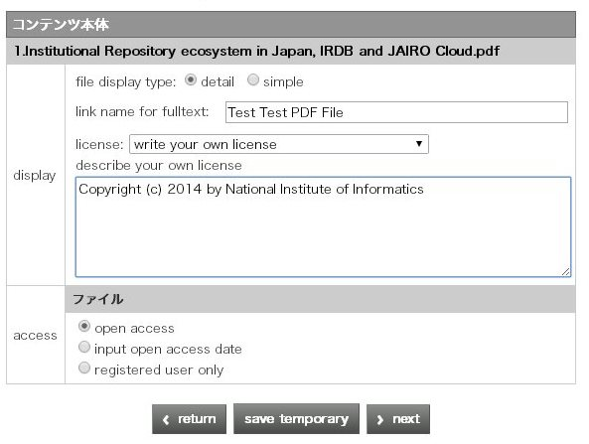
5. File License and Access Control (2/7)
Apply License to the attached file
  Select free description or Creative Commons
In case of free description, you can write it as you want in this text area.

Slide 9
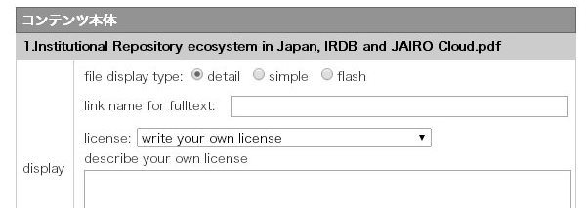
5. File License and Access Control (3/7)
Select file display option in the contents detail page.
Select one from “detail”, “simple”, “flash”.
=> Click “next”
Select one of them.
See next page in detail.

Slide 10
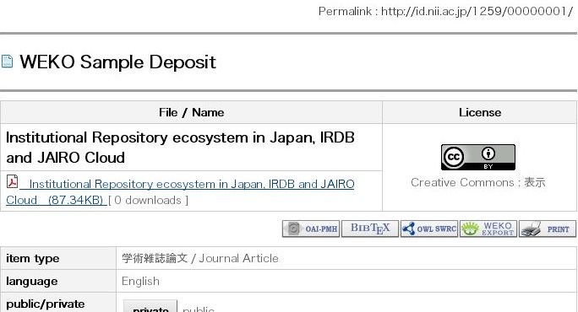
5. File License and Access Control (4/7)
  “detail”
Contents file information will be appeared on the top of the contents detail page.

Slide 11
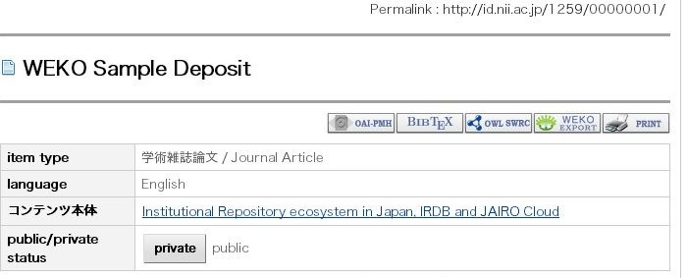
5. File License and Access Contr (5/7)
  “simple”
Contents link simply appeared in the metadata description.

Slide 12
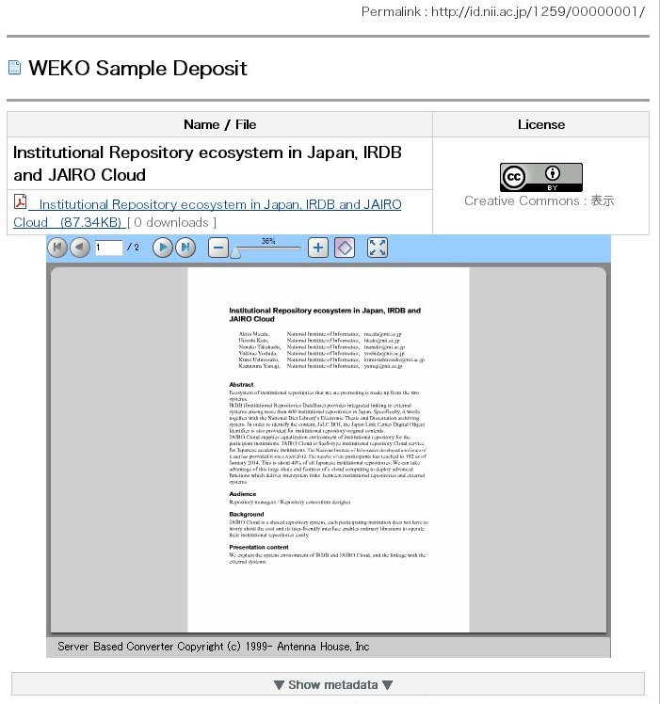
5. File License and Access Control (6/7)
  “flash”
You can show your contents in the web page.

Slide 13
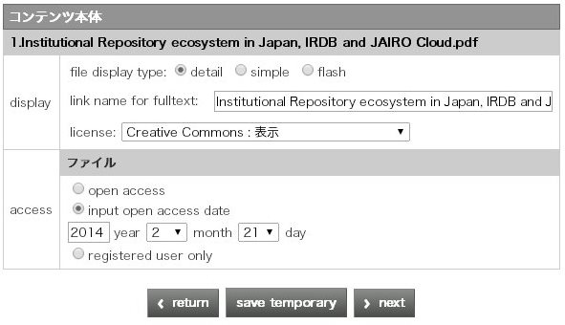
5. File License and Access Control (7/7)
Select access control option to the file
  Open access: anyone can access to the file immediately.
  Input open access data: same as the above but from the date you assigned.
  Registered user only: only the logged-in user can access to the file.
Click “next” button
Select one of them,
Then click “next”!

Slide 14
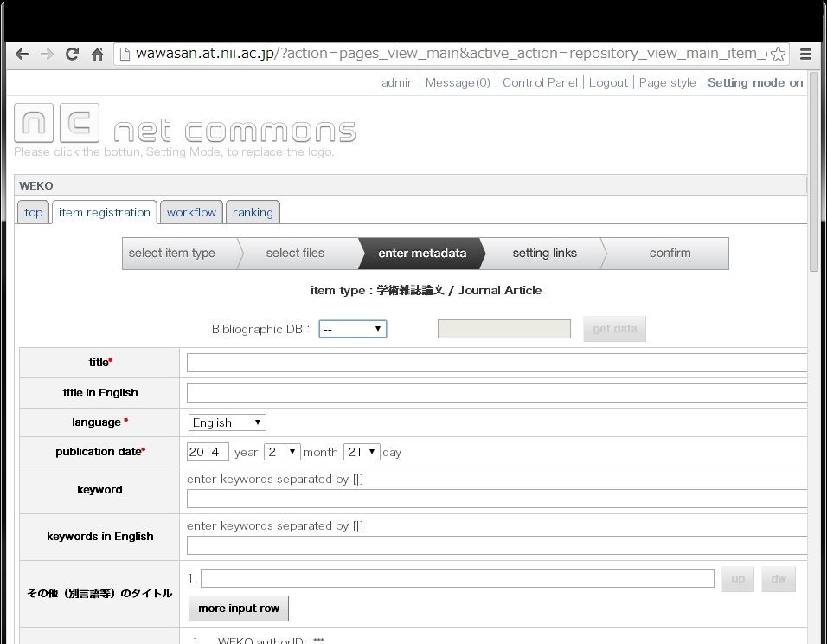
6. Metadata Registration
Input metadata in this screen
  “More input row” allow you to input multiple metadata
  You can auto fill the metadata from the external database (next page in detail)

Slide 15
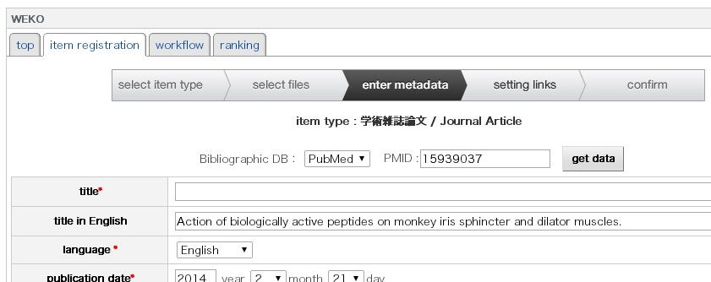
6-1. Metadata Auto-Fill (1/2)
Select External Database from the Pull-Down Menu
Input ID
Click “get data” button
Confirm filled metadata

Slide 16
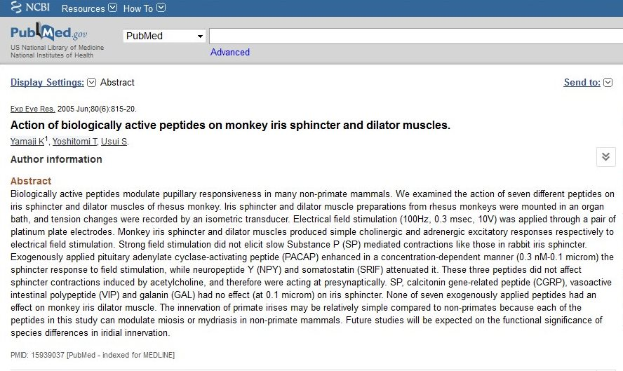
6-1. Metadata Auto-Fill (2/2)
In case of PubMed
  Access to the PubMed site and search the paper.
Copy ID from the contents page.
Copy PMID

Slide 17
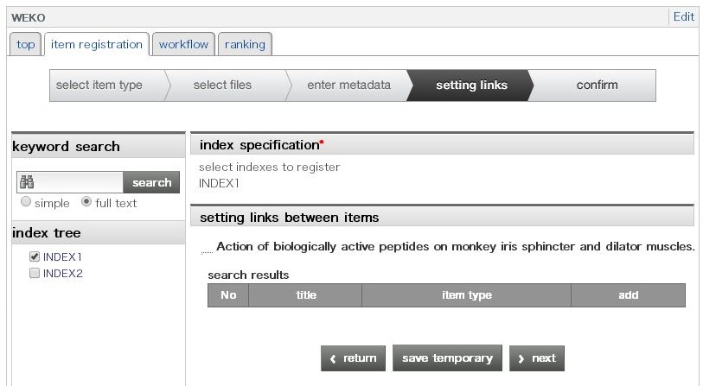
7. Index Tree Select
Check index from the tree
  Multiple selection is also available.
Click “next” button
Select index from the tree
Click “next”!

Slide 18
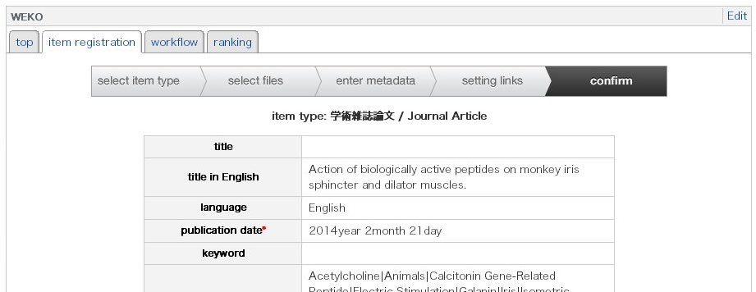
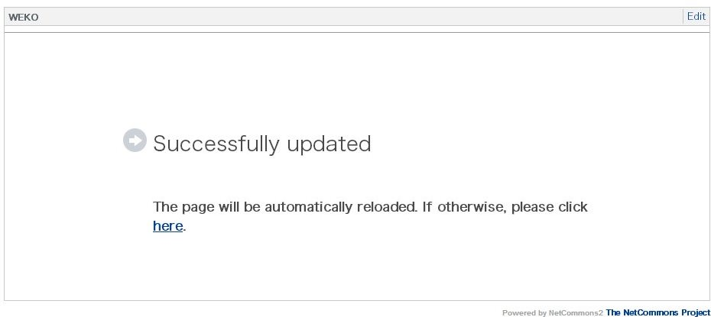
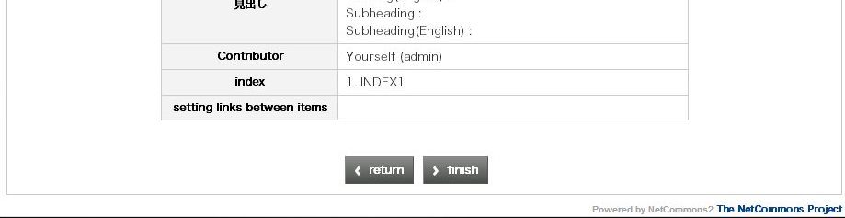
8. Confirmation
Confirm Information
Click “confirm” button
Final confirmation flow
Click finish!

Slide 19
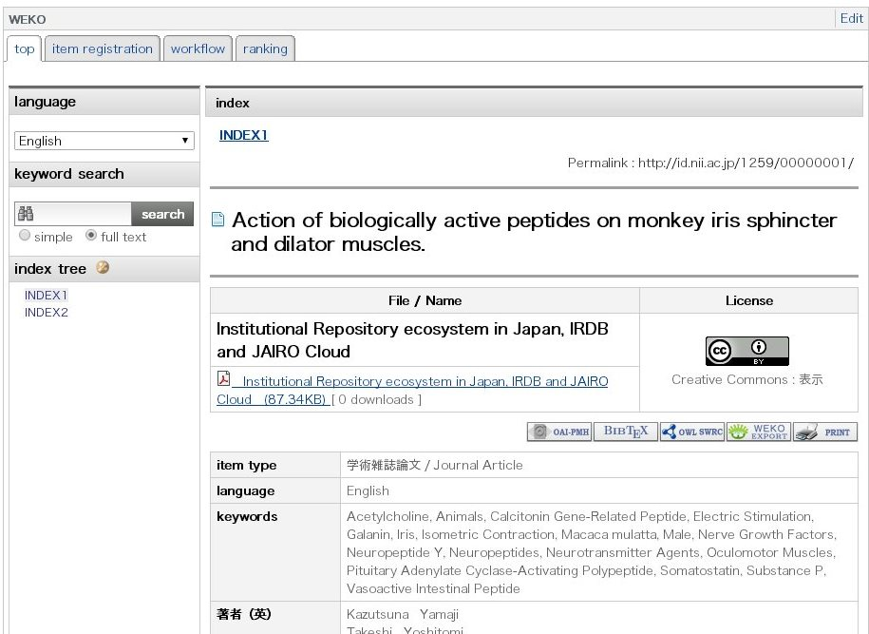
9. Conform Registered Item
Click “top” tab and search the registered contents by using index tree or keyword search.

